Slide 1
Real-time Wavelets with Shallow Water Simulation in WebGPU
2025 Fall CIS 565 Final Project
Qirui Fu
Pavel Peev
Tianhong Zhou

Slide 2
Goals and Outcomes
Application of GPU
Reproduce the Generalizing Shallow Water Simulation with Dispersive Surface Waves (SIGGRAPH 2023) model using WebGPU.
Achieve real-time, large-scale water wave propagation that supports reflection, refraction, obstacle interaction, and correct shallow water border interaction.
Incorporate interactive control features, including wave painting, dropping objects into the water, and clicking to create ripples.
Final deliverable: a WebGPU demo showcasing an interactive scene with multiple islands and boats of many sizes, as well as aforementioned interactive controls.
The Water Surface Wavelets model evolves a 4D amplitude field across space, frequency, and direction, while the shallow water model applies realistic interactions within shallow waters such as shores.
Updating millions of local wave components each frame requires heavy advection and diffusion operations.
These computations are highly parallel, making GPU acceleration essential for real-time performance.
GPU compute enables large-scale, high-resolution wave propagation and rendering at interactive frame rates.

Slide 3
Why This Project Matters
Schedule for Milestones
Most interactive water simulations rely on FFT or Gerstner wave models, which cannot interact with moving objects or local obstacles. Others are particle based, and as such cannot be scaled to large scale simulations.
This project bridges physics-based simulation and real-time graphics, bringing a research-level algorithm into WebGPU
It demonstrates how GPU-accelerated PDE solvers can enable artist-driven and physically plausible water animation.
Milestone 1: Implement GPU pipeline & wavelet and shallow water advection equations
Milestone 2: Height reconstruction and rendering with dynamic tessellation
Milestone 3: Add real-time interaction: solid-fluid coupling & wave painting & other interactivities
Final: Interactive demo + performance analysis + visual showcase video

Slide 4
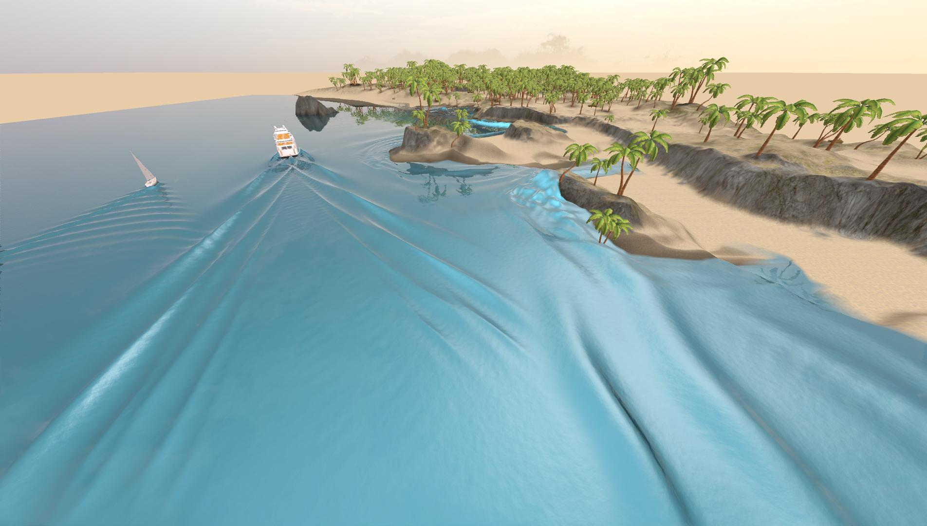
APIs and Platforms
References
WebGPU
Javascript
Github Pages
Stefan Jeschke and Chris Wojtan. 2023. Generalizing Shallow Water Simulations with Dispersive Surface Waves. ACM Trans. Graph. 42, 4, Article 83 (August 2023), 12 pages. https://doi.org/10.1145/3592098
Stefan Jeschke, Tomáš Skřivan, Matthias Müller-Fischer, Nuttapong Chentanez, Miles Macklin, and Chris Wojtan. 2018. Water surface wavelets. ACM Trans. Graph. 37, 4, Article 94 (August 2018), 13 pages. https://doi.org/10.1145/3197517.3201336

